Slide 1
What to Do with an Uncertain Future
Ecclesiastes 11:1-6
Dr. Rick Griffith • Crossroads International Church Singapore
CICFamily.com • BibleStudyDownloads.org

Slide 2
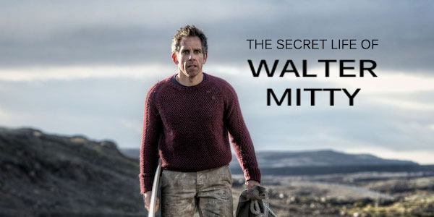
The Secret Life of Walter Mitty Trailer
Notes:
https://www.youtube.com/watch?v=HddkucqSzSM
In the 2013 movie, “The Secret Life of Walter Mitty,” Ben Stiller epitomizes the longings for adventure that many of us have for our future. Yet the future is unknown.

Slide 3
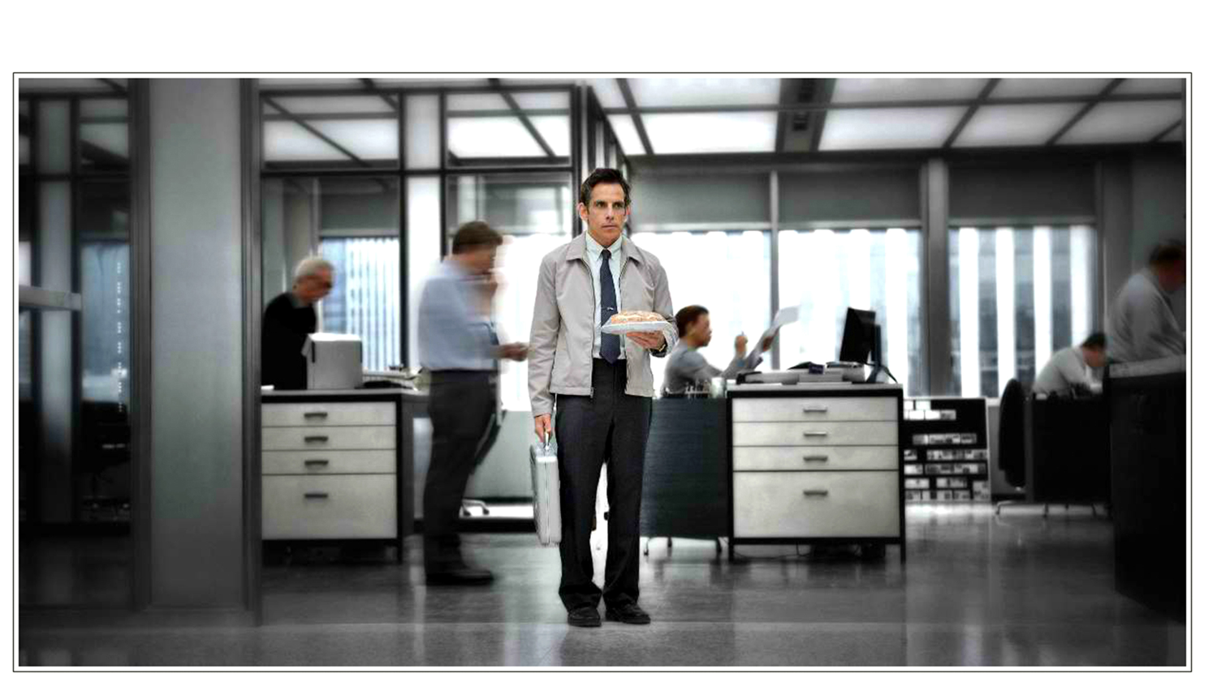
The Cautious Life
Notes:
Walter lives what I call “the cautious life.”

Slide 4
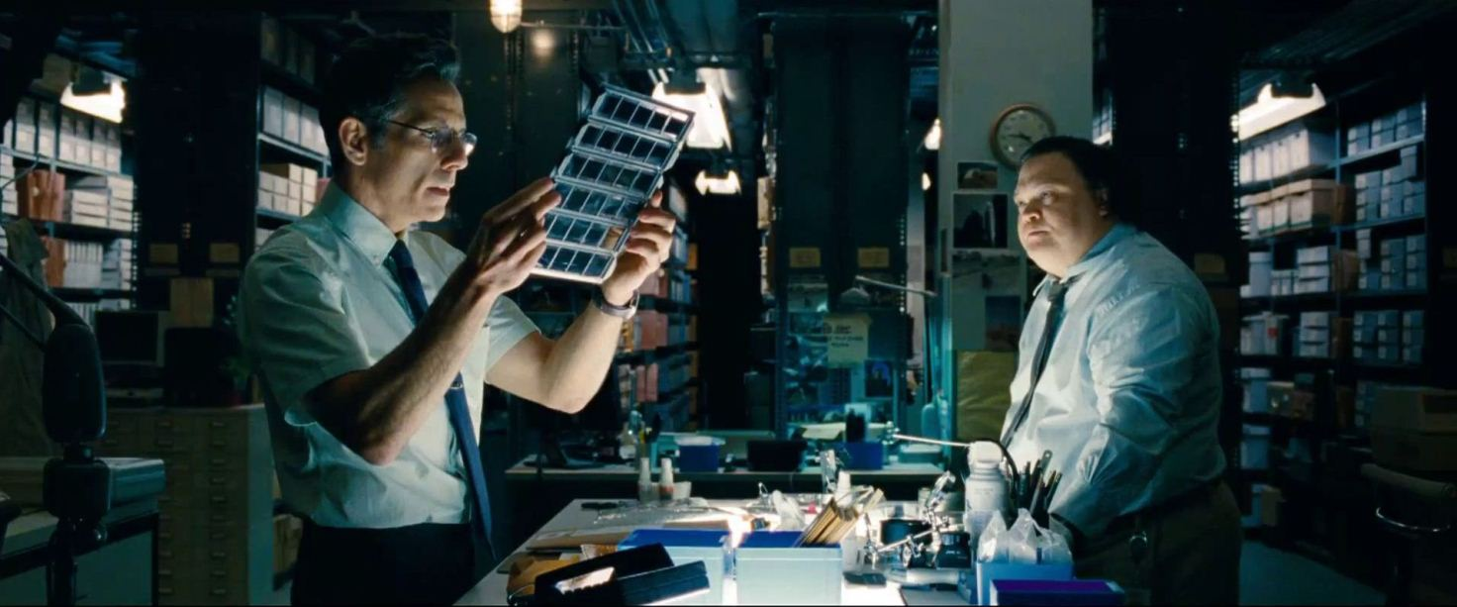
The Cautious Life
Notes:
He handles negatives for Life magazine—an insignificant, dead-end job.

Slide 5
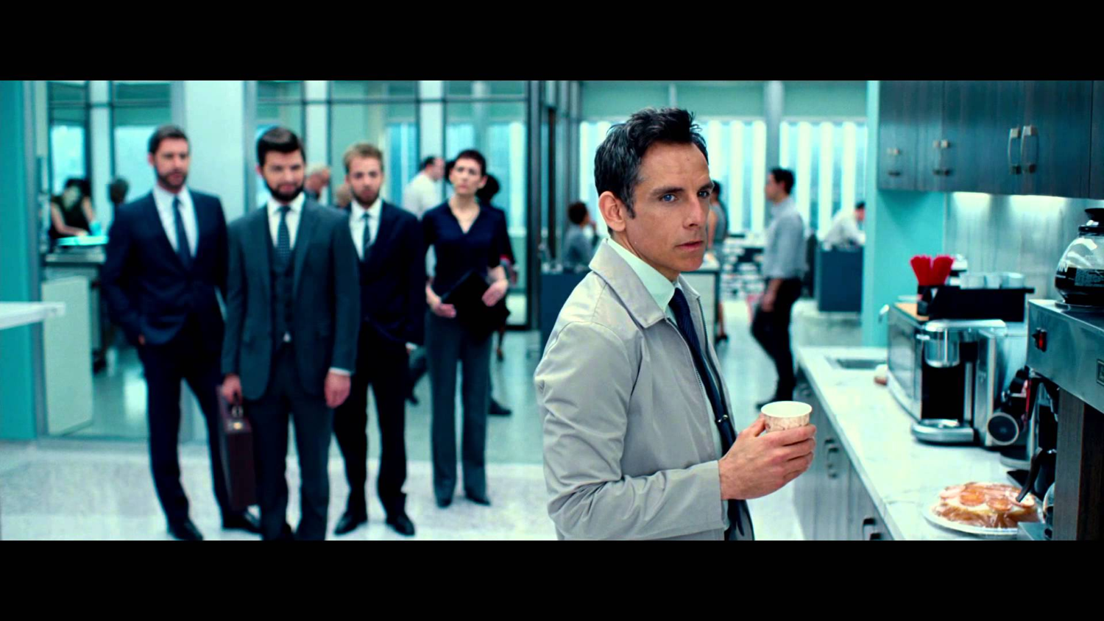
The Cautious Life
Notes:
A company reshuffling forces him out.

Slide 6
The Cautious Life
Notes:
So he dreams how he could ever see his dream woman there again. His “secret life” refers to his daydreaming about doing something he deems significant.

Slide 7
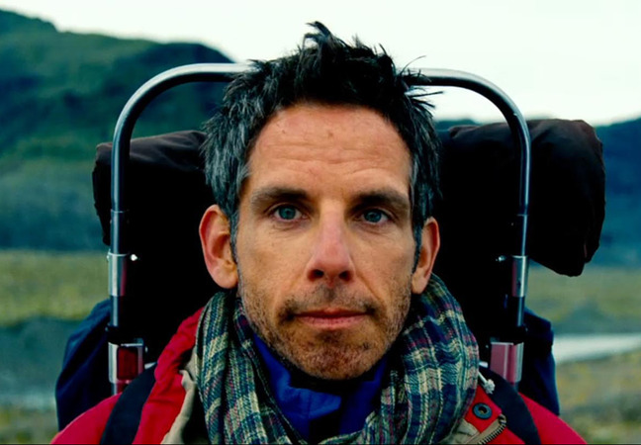
The Adventuresome Life
Notes:
So he, all-of-a-sudden, dares to embrace what I call “The Adventuresome Life.”

Slide 8
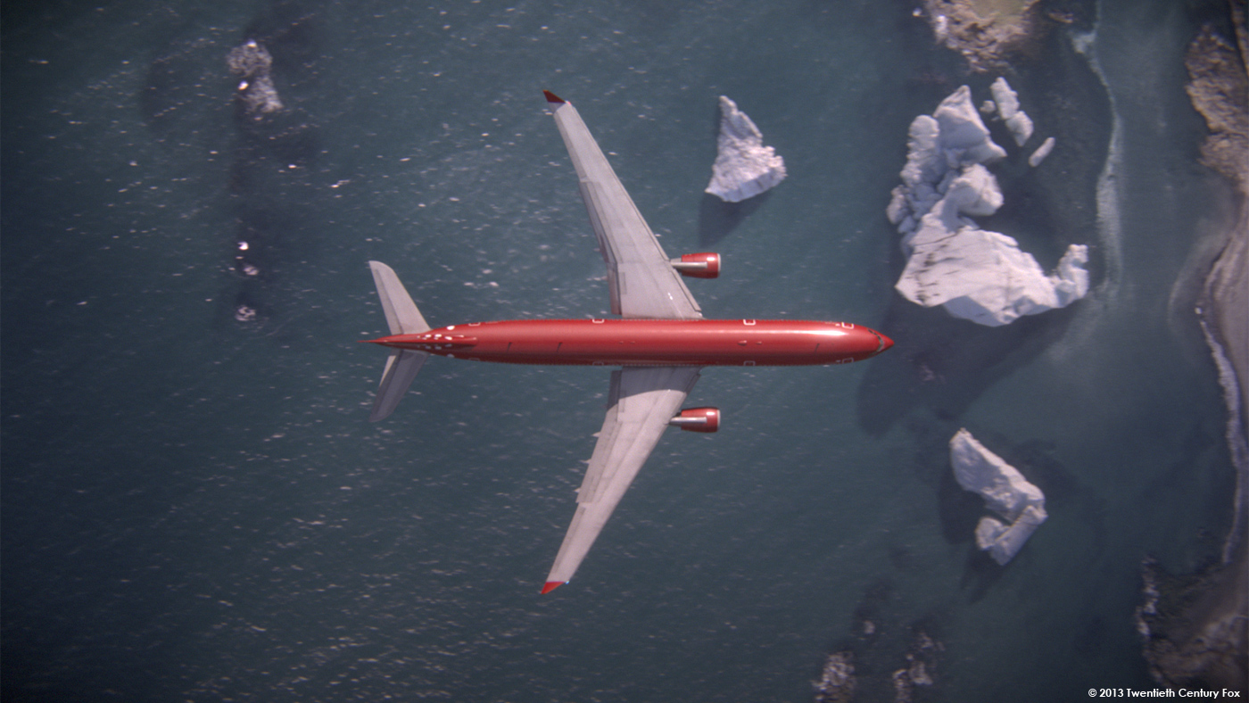
The Adventuresome Life
Notes:
This leads him to Iceland…
He takes on a shark in the ocean…
Skateboards towards a volcano…
…all with dreams of being a “real somebody” in his future.
Why? He wants to embrace his uncertain future with confidence, risk, and no fear.

Slide 9
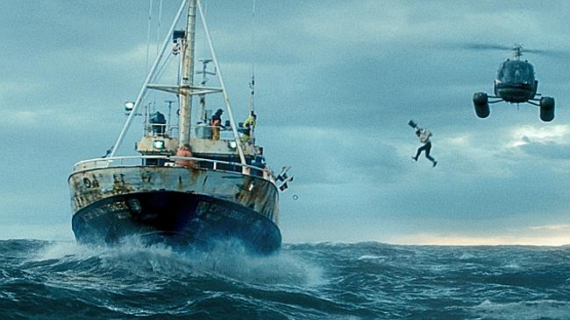
The Adventuresome Life
Notes:
This leads him to Iceland…
He takes on a shark in the ocean…
Skateboards towards a volcano…
…all with dreams of being a “real somebody” in his future.
Why? He wants to embrace his uncertain future with confidence, risk, and no fear.

Slide 10
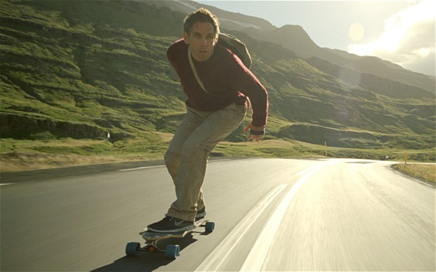
The Adventuresome Life
Notes:
This leads him to Iceland…
He takes on a shark in the ocean…
Skateboards towards a volcano…
…all with dreams of being a “real somebody” in his future.
Why? He wants to embrace his uncertain future with confidence, risk, and no fear.

Slide 11
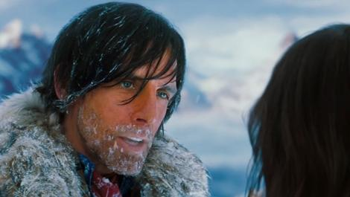
The Adventuresome Life
Notes:
This leads him to Iceland…
He takes on a shark in the ocean…
Skateboards towards a volcano…
…all with dreams of being a “real somebody” in his future.
Why? He wants to embrace his uncertain future with confidence, risk, and no fear.

Slide 12
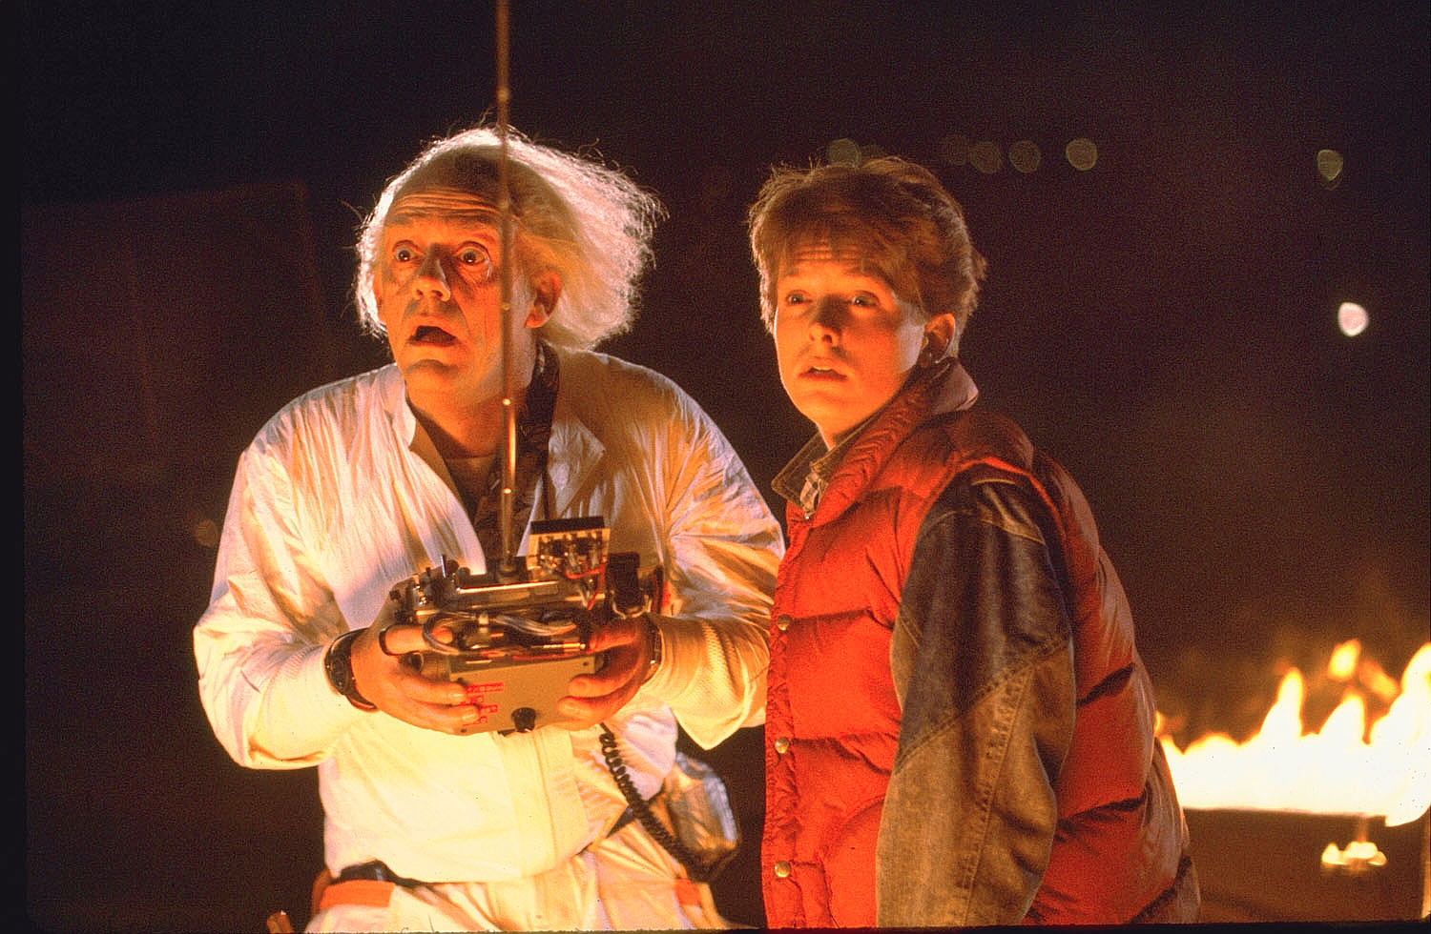
Back to the Future
Notes:
None of us knows the future.

Slide 13
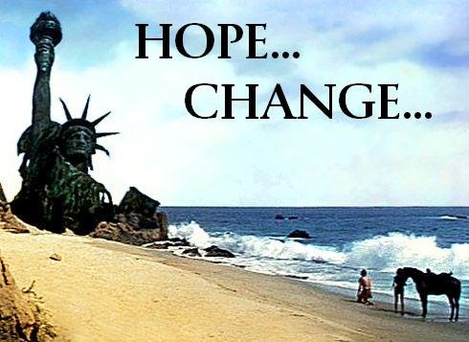
Hope… Change…
Notes:
The 2008 US presidential election was won on “Hope and Change” in the future.

Slide 14
Pulpit Freedom Sunday
Notes:
This very weekend we see one of those changes—The Reformation Project—a so-called “Bible-based, Gospel-Centered, LGBT Inclusion” conference!

Slide 15
What's going to happen to marriage?
Notes:
None of us knows the future of the institution of marriage

Slide 16
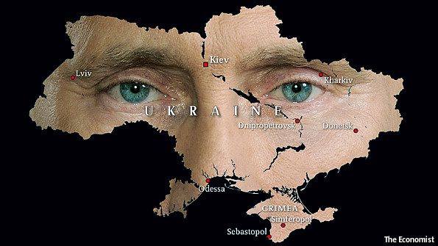
Ukraine
Notes:
We don’t know what’s going to happen in Ukraine or any other place
________
Crisis in Ukraine
Kidnapped by the Kremlin
The West can punish Putin's Russia for its belligerence in Ukraine. But only if it is prepared to pay a price
Mar 8th 2014
http://www.economist.com/news/leaders/21598639-west-can-punish-putins-russia-its-belligerence-ukraine-only-if-it-prepared

Slide 17
How does the uncertainty of the future affect you?
• Giving? • Investments? • Work?
Notes:
How does an uncertain future influence your giving?
How does an uncertain future influence your investments?
How does an uncertain future influence your work?

Slide 18
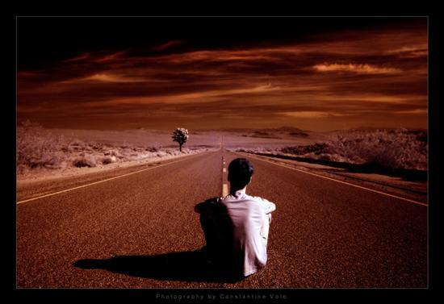
How should your uncertain future influence you?

Slide 19
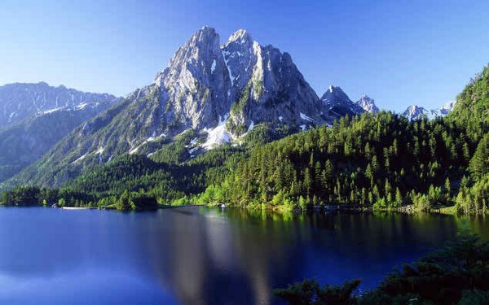
LIVE Don't just exist!
Notes:
Solomon's advice is, “Don’t just exist—live!”
“Don’t be satisfied with ho-hum existence—live!”

Slide 20
Our Uncertain Future
Ecclesiastes 11:1-6
Money (1-3)
Work (4-6)
Notes:
Today we will see how our ignorance of the future gives us wisdom about money (11:1-3) and work (11:4-6)
Here Solomon first says that your uncertain future affects your view of your money—so...

Slide 21
I. Give generously and invest wisely (11:1-3).
Notes:
Hold money loosely but discerningly since you don't know the future

Slide 22
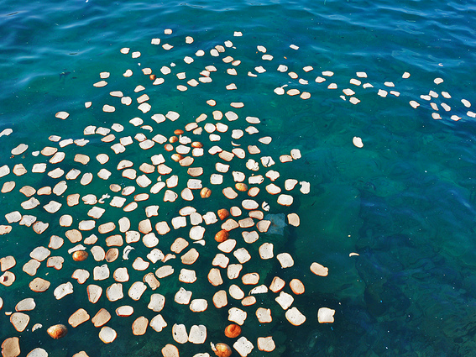
"Cast your bread upon the waters, for after many days you will find it again" (11:1 NIV).
"Send your grain across the seas, and in time, profits will flow back to you" (11:1 NLT).
Notes:
“Cast your bread upon the waters,” says the NIV. And what will you get? Soggy bread?
What’s the point?
Give generously, for your gifts will return to you later (11:1)
The NLT sees this exclusively referring to business profits [read NLT]
However, can’t it also refer to giving?

Slide 23
Missions Giving
20%
Notes:
We do this as a family, as we support about seven missionary families—Poolman (Thailand), Roxas (Philippines), Shehadeh (Jordan), Gleason (Nepal), Low (Hong Kong), Berkey (Venezuela), Children of Promise (Africa). We also manage giving from our USA church to students from Mongolia and India.
Our church supports work outside of Singapore with 20% of the offerings given.

Slide 24
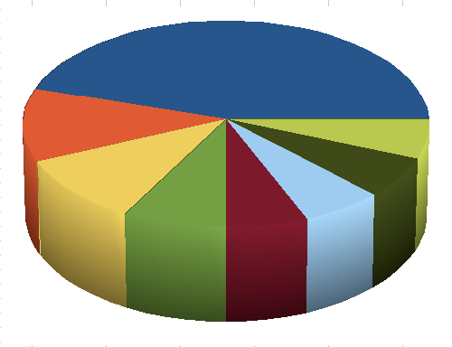
"But divide your investments among many places, for you do not know what risks might lie ahead" (11:2 NLT).
Notes:
Don't hoard, but give and invest since you don't know the future (11:2).

Slide 25
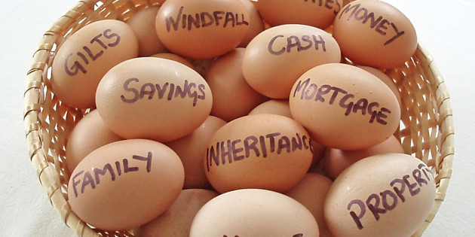
"Don't put all your eggs into one basket"
Notes:
Don’t "put all your eggs in one basket" since you don't know which ventures will fail (11:2b).

Slide 26
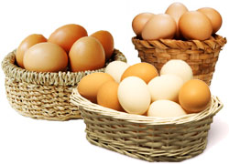
"Don't put all your eggs into one basket"
Notes:
It is wise to put those eggs into different baskets.

Slide 27
Uncertain Future
Notes:
Why? Uncertain future. No one knows which eggs will hatch.

Slide 28
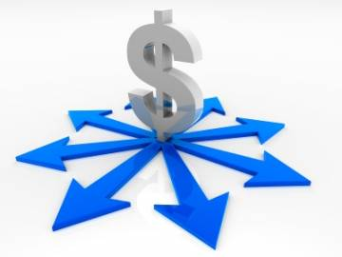
Diversify
Notes:
Susan and I discovered yesterday that we have our retirement planning divided into nine different sources of income. Since we don’t own a home, this is especially necessary in our case.

Slide 29
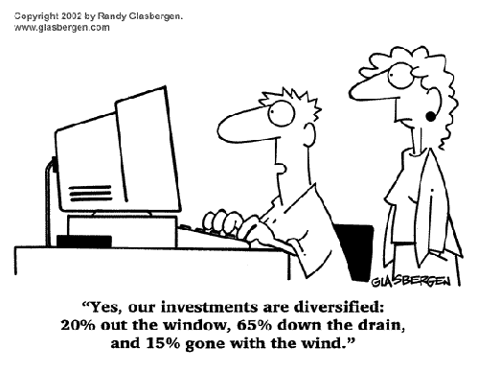
Diversify Investments
"Yes, our investments are diversified: 20% out the window, 65% down the drain, and 15% gone with the wind."
Notes:
I can relate to this as I really have little idea about our investments.

Slide 30
Crossroads Missions Funds 2014
MONGOLIA
BANGLADESH
PAKISTAN
NEPAL
MYANMAR
INDIA
10-40 Window
THAILAND
INDONESIA
SINGAPORE
Notes:
CIC regularly supports cross-cultural missionaries in Thailand, Myanmar, and a family headed to Indonesia. Semi-regular gifts go to Pakistan, India, Bangladesh, Nepal and Mongolia.

Slide 31
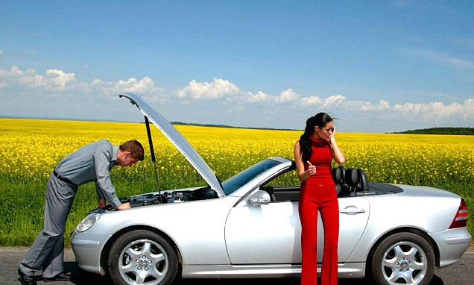
One egg…

Slide 32
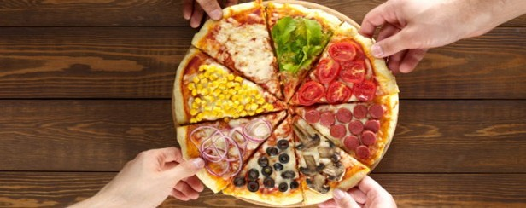
Spread the Risk

Slide 33
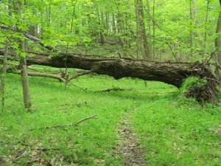
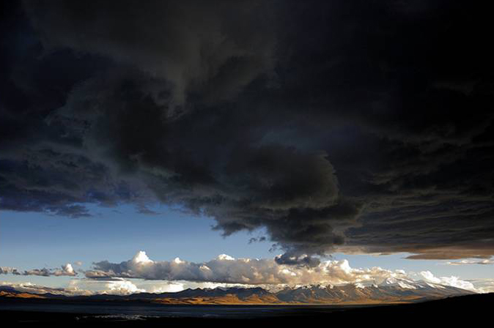
"When clouds are heavy, the rains come down" (11:3a NLT).
"Whether a tree falls north or south, it stays where it falls" (11:3b NLT).
God's providence controls everything that we can't control— so give generously and invest wisely!
Notes:
Man can't stop the clouds from giving rain (11:3a).
Man can't control where trees fall (11:3b).

Slide 34
I. Give generously and invest wisely (11:1-3).
Notes:
Hold money loosely but discerningly since you don't know the future

Slide 35
Our Uncertain Future
Ecclesiastes 11:1-6
Money (1-3)
Work (4-6)
Notes:
So our ignorance of the future gives us wisdom regarding money. This ignorance tells us to give generously and invest wisely. But also, our ignorance of the future should also improve our attitude toward work. Your uncertain future affects your work, so…

Slide 36
II. Work hard due to your uncertain future (11:4-6).
Notes:
Don’t let your ignorance of the days to come lead to apathy.

Slide 37
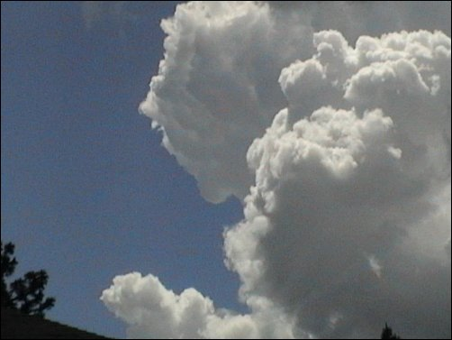
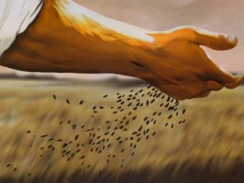
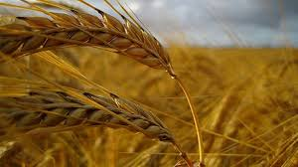
"He who watches the wind will not sow and he who looks at the clouds will not reap" (11:4 NAU).
"Farmers who wait for perfect weather never plant. If they watch every cloud, they never harvest" (11:4 NLT).
Notes:
Don’t wait for the wind to die down (so the seed won't be scattered) or you’ll never plant seed (11:4a).
Don’t watch the clouds (to make sure it won't rain) or you’ll never harvest a crop (11:4b).

Slide 38
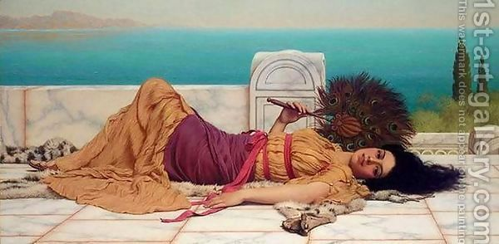
Idleness or procrastination never helps anything (11:4).

Slide 39
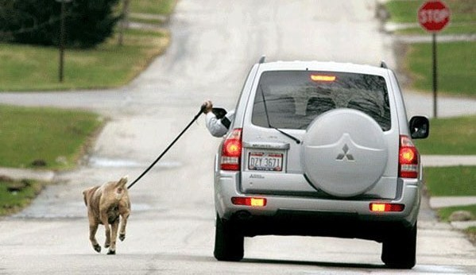
Laziness
Notes:
It’s amazing the ingenuity lazy people can show—too bad they don’t take all that creativity and apply it to actual work!

Slide 40
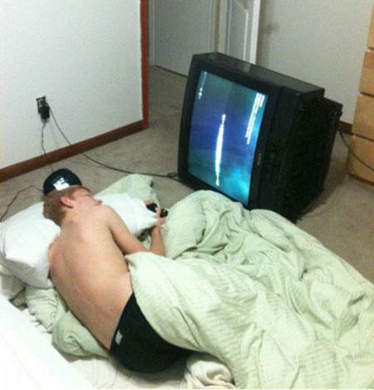
LAZINESS
Is it harder to move the TV or the body?

Slide 41
LAZINESS
But the stick got in my way!

Slide 42
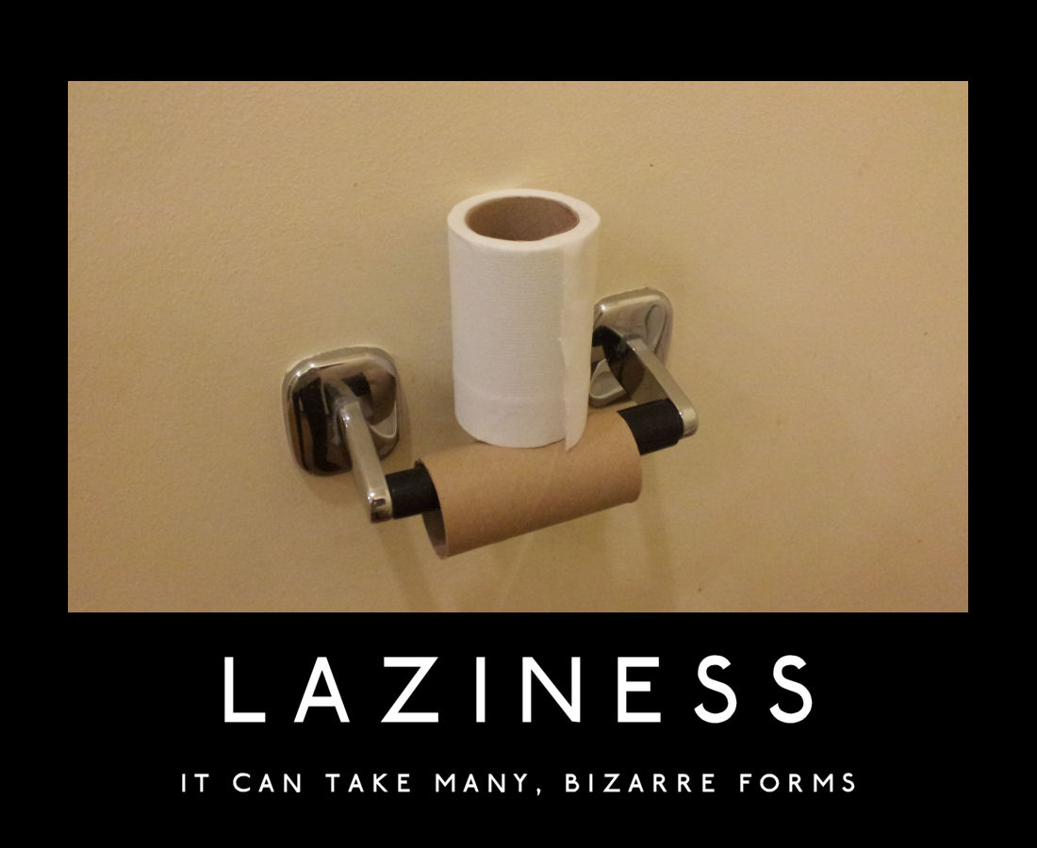
LAZINESS
It can take many, bizarre forms

Slide 43
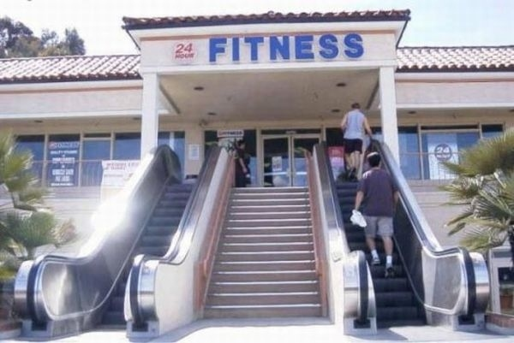
There is no excuse

Slide 44
"Just as you cannot understand the path of the wind…"
Notes:
We don't know how God works (11:5)

Slide 45
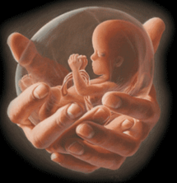
"…or the mystery of a tiny baby growing in its mother's womb, so you cannot understand the activity of God, who does all things" (11:5 NLT).
Notes:
We can't know how God controls everything any more than we can know the wind or prenatal growth (11:5c).

Slide 46
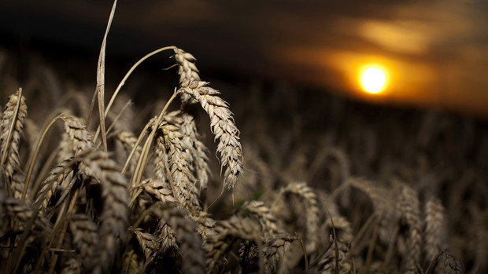
"Plant your seed in the morning and keep busy all afternoon, for you don't know if profit will come from one activity or another—or maybe both" (11:6 NLT).
Notes:
Work many tasks since you don't know which ones will succeed (11:6).

Slide 47
Diversified Ministries
WorldVenture
Singapore Bible College
International Community School
Crossroads International Church
Adjunct Teaching
The Bible…Basically
Biblestudydownloads.com
Notes:
I have expanded by original appointment by WorldVenture at SBC to ICS, CIC and other nations because I don’t know which efforts will succeed. Through TBB we have Bible teaching in 38 languages, as I’m not sure which ones will be blessed or get downloaded via the biblestudydownloads.com site.

Slide 48
www.cicfamily.com
Notes:
At cicfamily.com we post the sermons, not knowing how many downloads.

Slide 49
www.cicfamily.com
Notes:
We "cast our bread upon the waters" with the belief that God will bless these efforts, but we have no idea which language or message or book will succeed.

Slide 50
How should your uncertain future influence you?

Slide 51
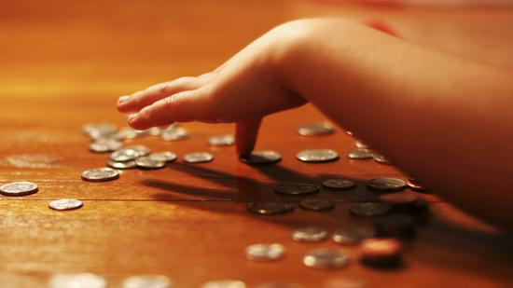
Give generously, invest wisely and work hard since you don't know your future.
Main Idea
Notes:
Ignorance of the future should give us wisdom about money and work (MI restated).

Slide 52
I. Give generously and invest wisely (11:1-3).
Notes:
Hold money loosely but discerningly since you don't know the future

Slide 53
II. Work hard due to your uncertain future (11:4-6).
Notes:
Don’t let your ignorance of the days to come lead to apathy.

Slide 54
So how should I live in light of my uncertain future?

Slide 55
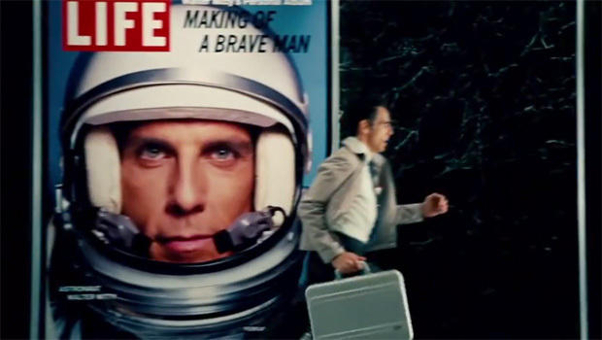
Walter Mitty Got It Wrong
Notes:
Walter Mitty only got it partly right—to live with adventure. Yet he never did anything that benefited others.
This is where you and I must be different, to the glory of God.

Slide 56
Do one thing every day that scares you.
Notes:
When was the last time you broke away from your routine and did something unusual (and even a bit strange) without being overly cautious?

Slide 57
Don't be regular
Notes:
Don’t misunderstand. I’m not saying to be stupid, but to entrust yourself to God in new areas!

Slide 58
Give generously
Notes:
Giving: To what extent do you give out of love without concern for return?

Slide 59
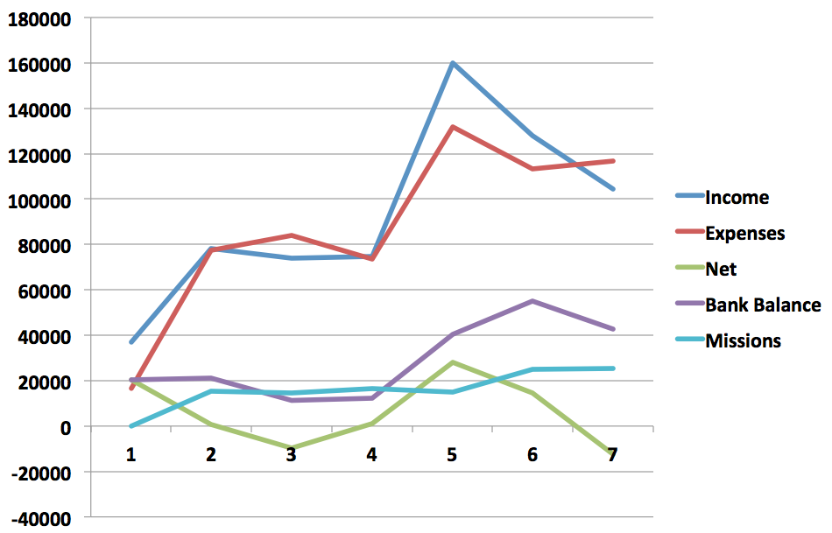
CIC Finances
Finances 2007-2014
Expenses exceed income $1000/month
07
08
09
10
11
12
13-14
Notes:
The issue is not amount, though we certainly need the giving here to improve as we lack about S$1000 monthly.

Slide 60
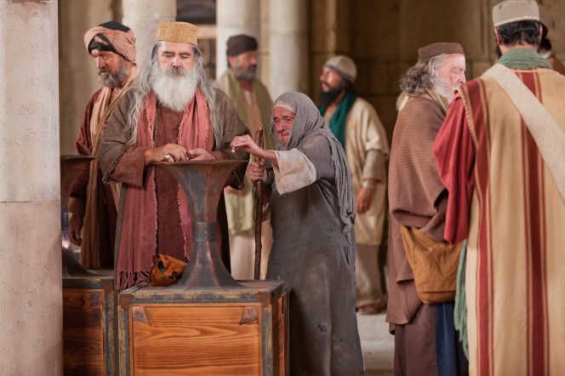
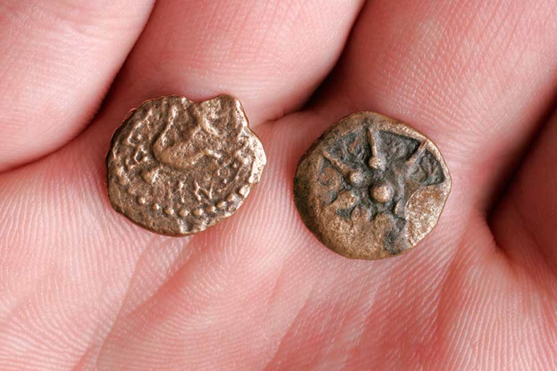
The Widow's Mites
Notes:
The key person Jesus approved for giving was a widow who gave two mites—two tiny copper coins worth less than a cent. Since then, most have given her credit for only one mite! Either way…

Slide 61
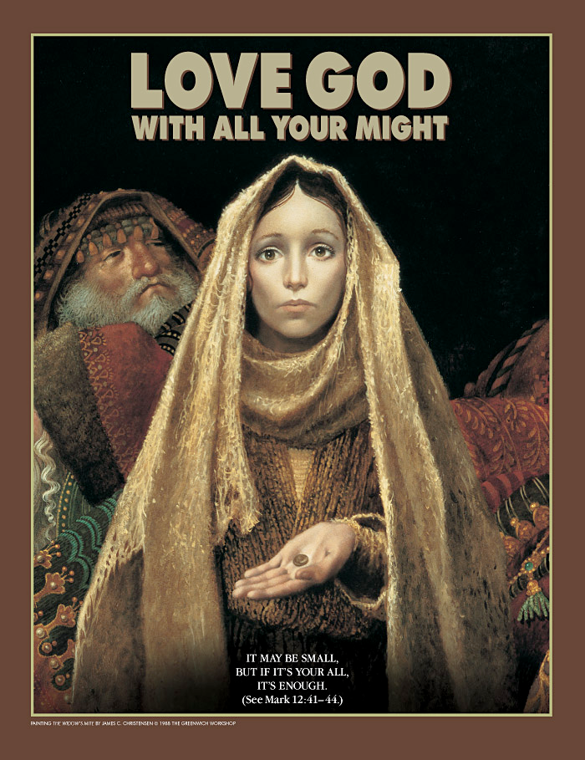
"It may be small, but if it's your all, it's enough" (Mark 12:41-44)
Notes:
Are you giving him your all?

Slide 62
A Sign
Notes:
Work Hard: What job have you been putting off due to being overcautious? If you were waiting for a sign, this is it!

Slide 63
Black

Slide 64
OT Preaching link at BibleStudyDownloads.org
Get this presentation and script for free!

